Slide 1

Notes:
Greetings/additional statements - Title

Slide 2

Notes:
(Innate location) In Washington, DC (national capital) in Dupont Circle district

Slide 3
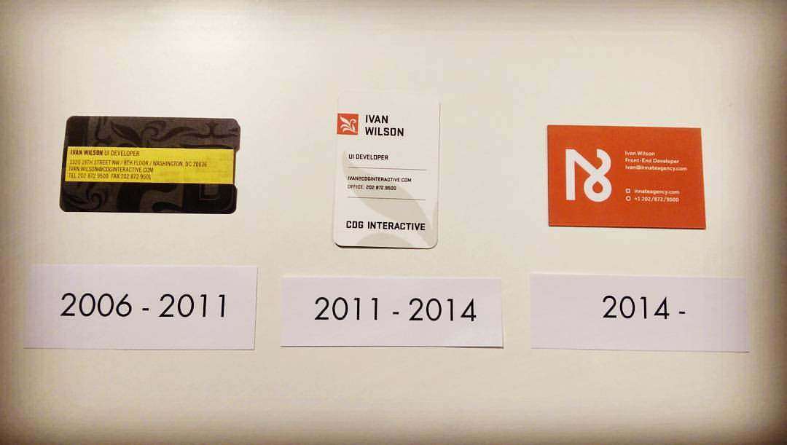
Notes:
10th Anniversary in April

Slide 4
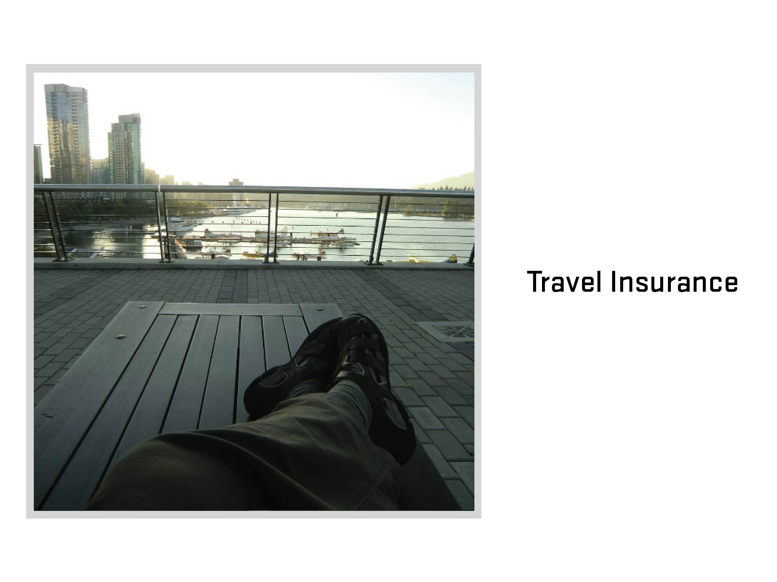
Notes:
Travel Insurance
What is travel insurance? (Ask audience)

Slide 5
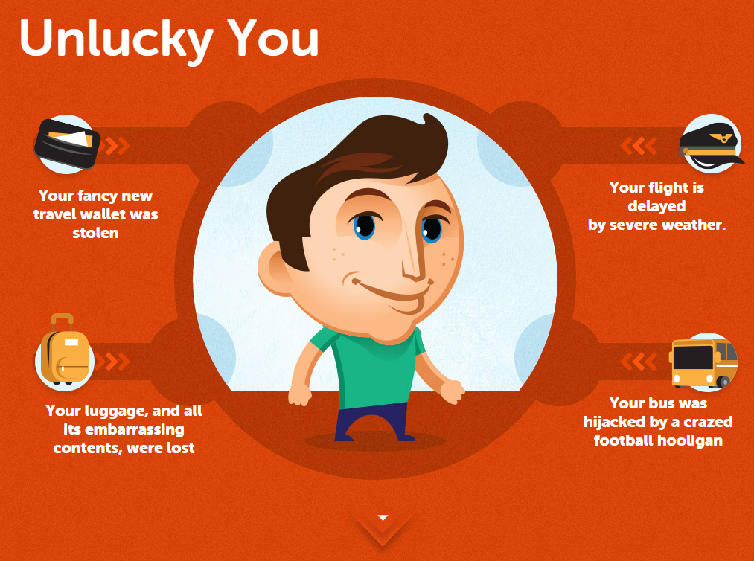

Slide 6
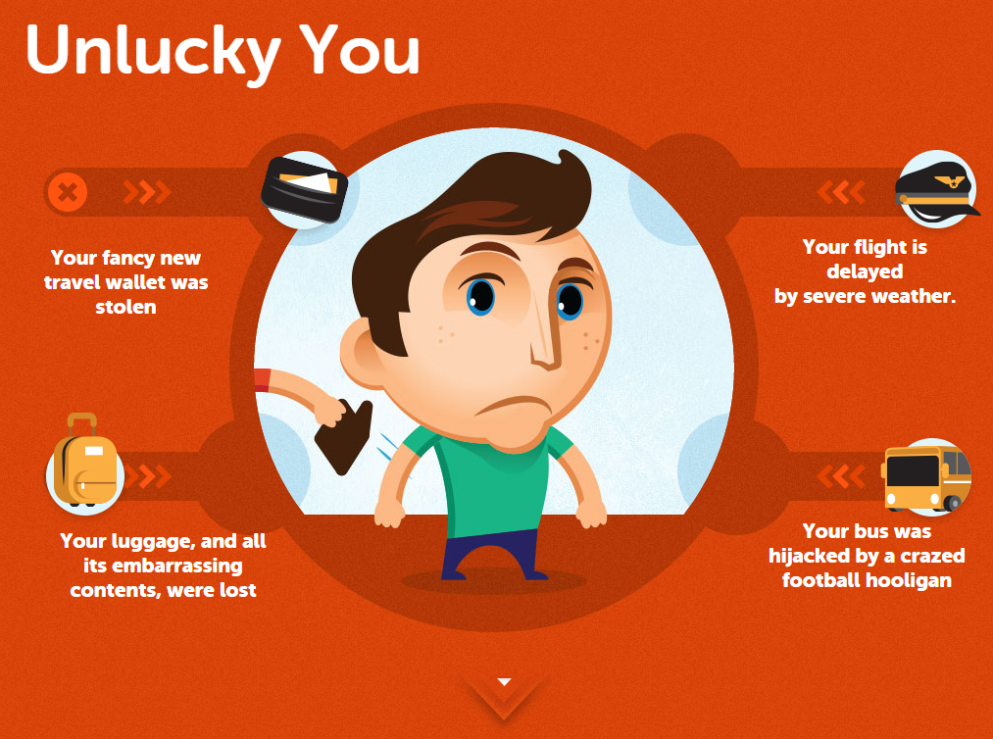

Slide 7
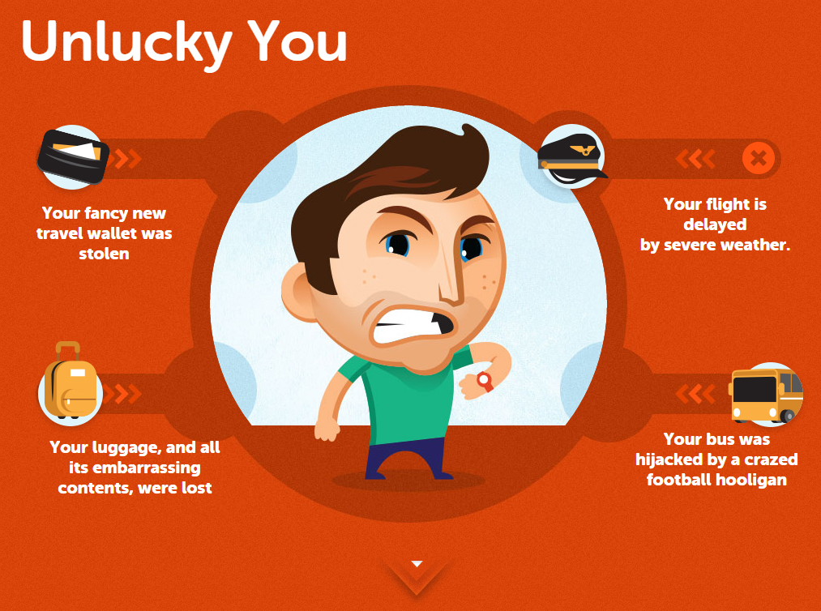

Slide 8
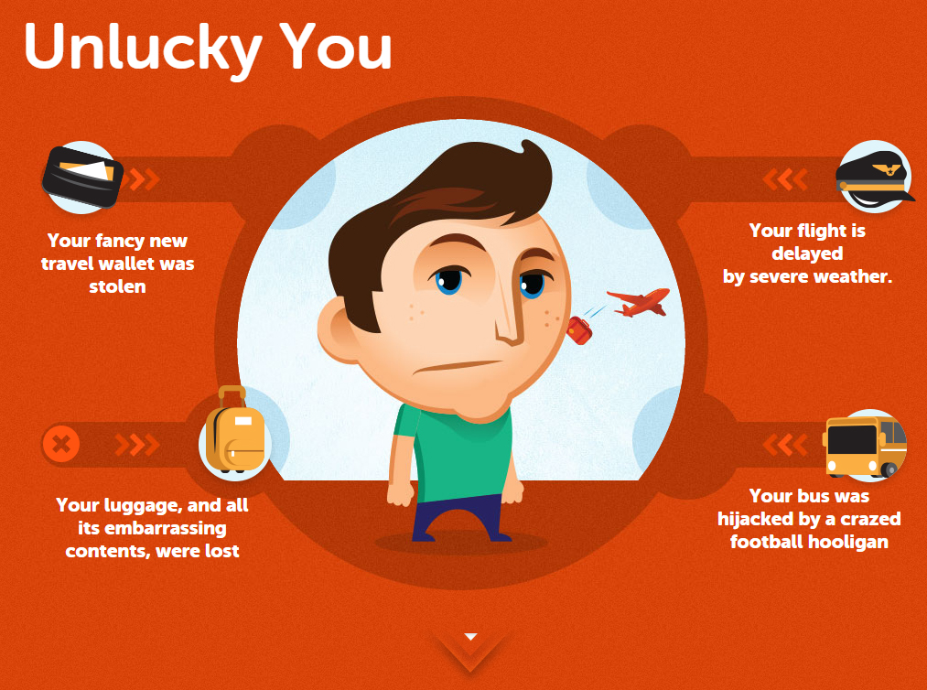

Slide 9
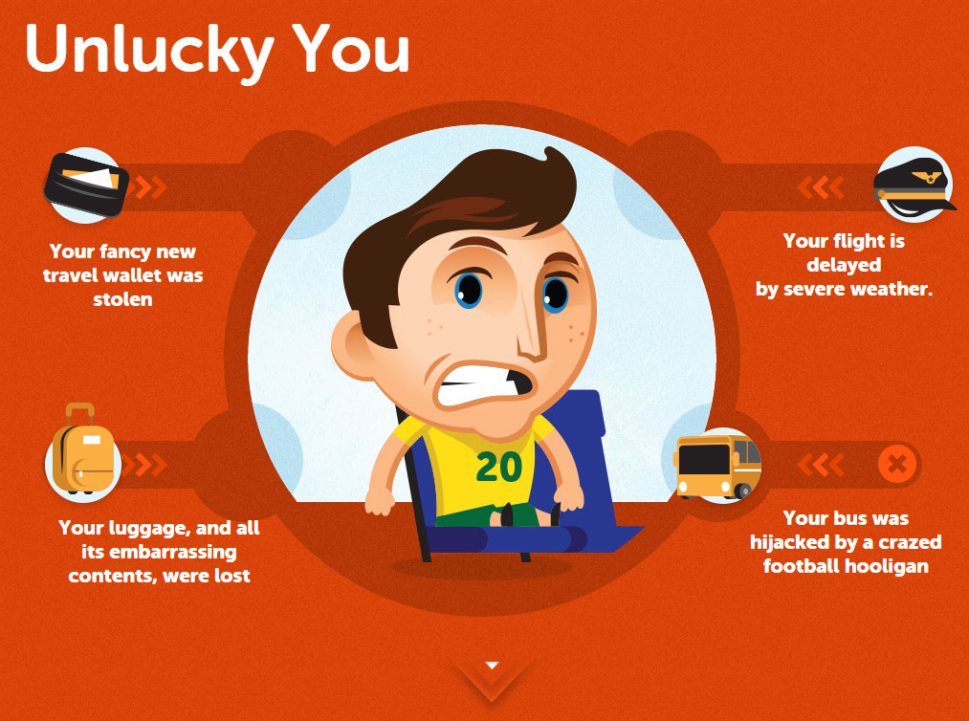

Slide 10
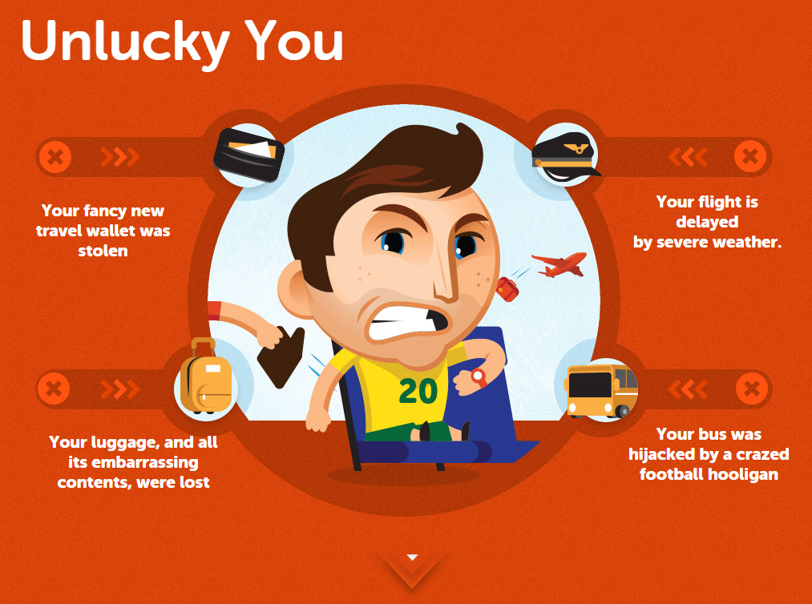

Slide 11
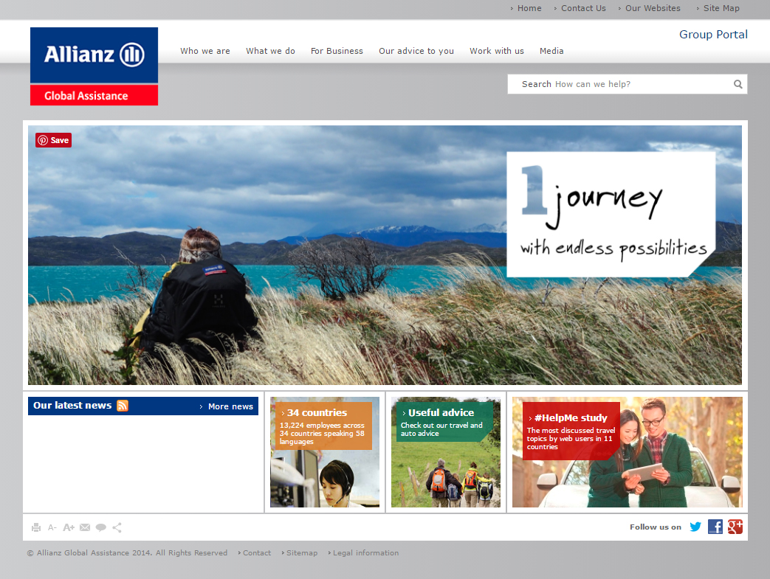

Slide 12


Slide 13
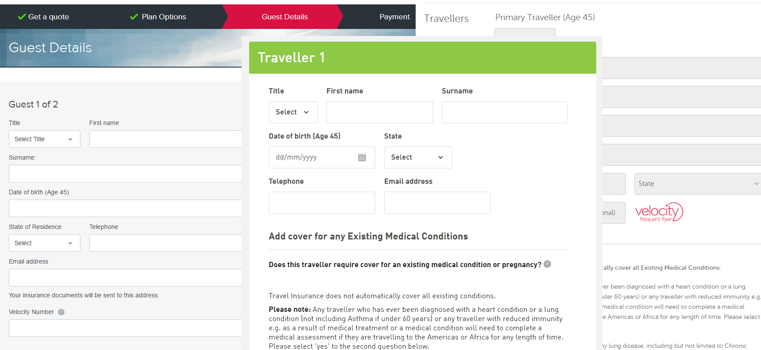

Slide 14
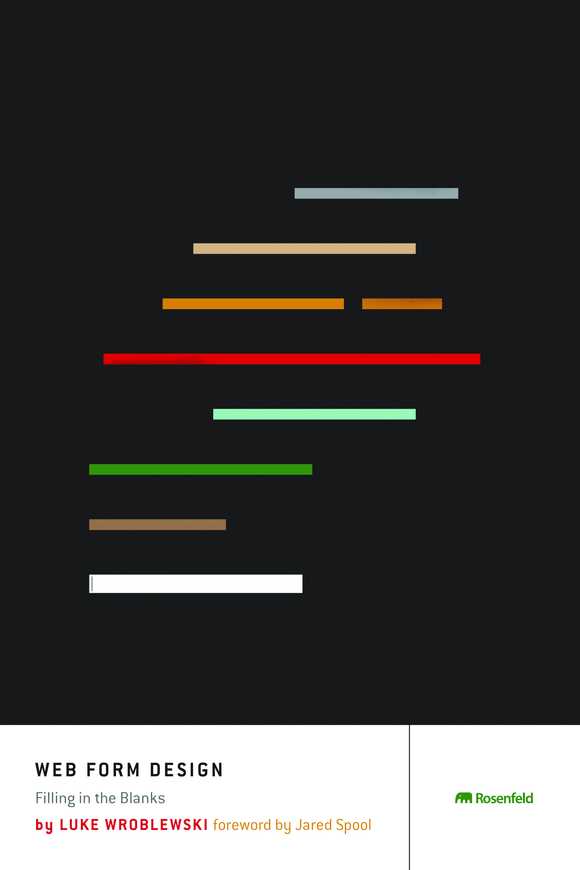

Slide 15
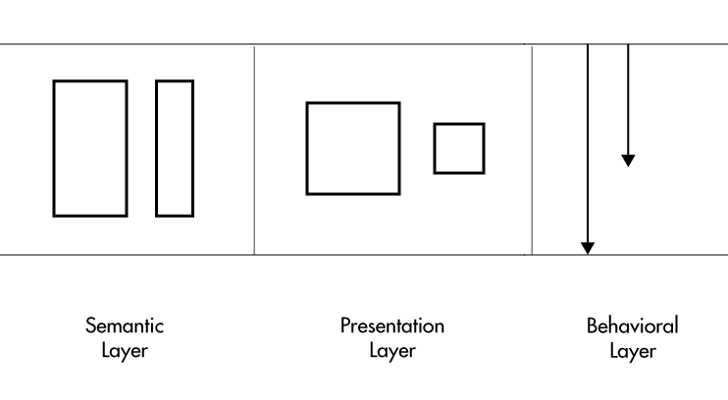

Slide 17
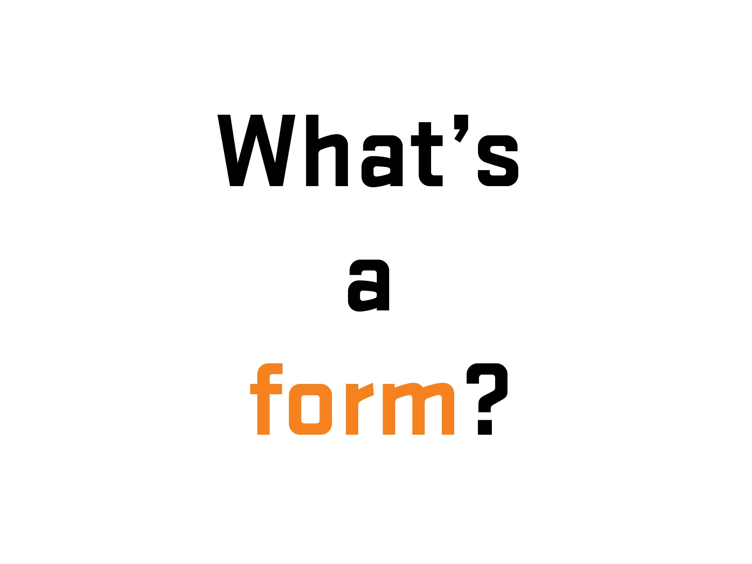

Slide 18
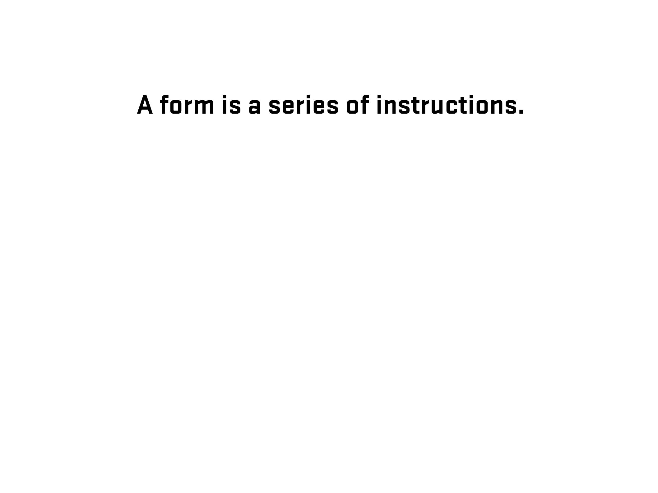

Slide 19
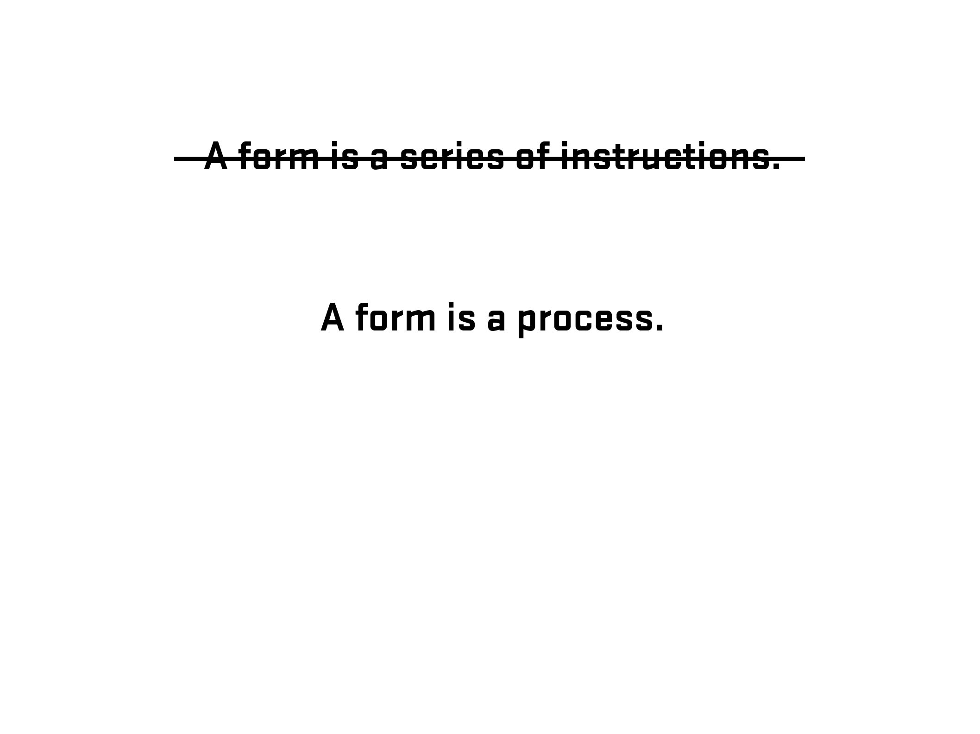

Slide 20
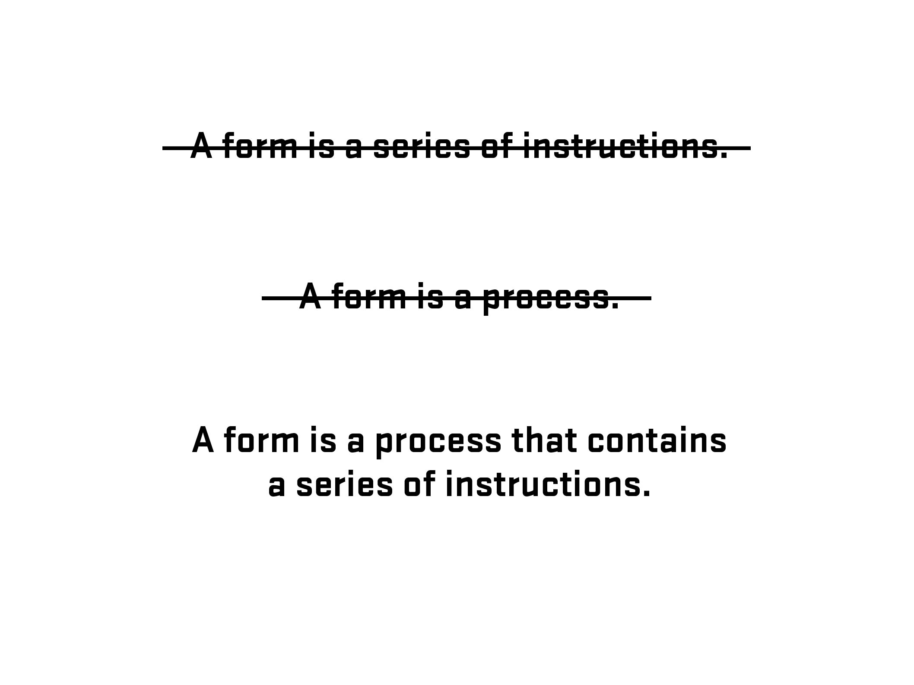

Slide 21
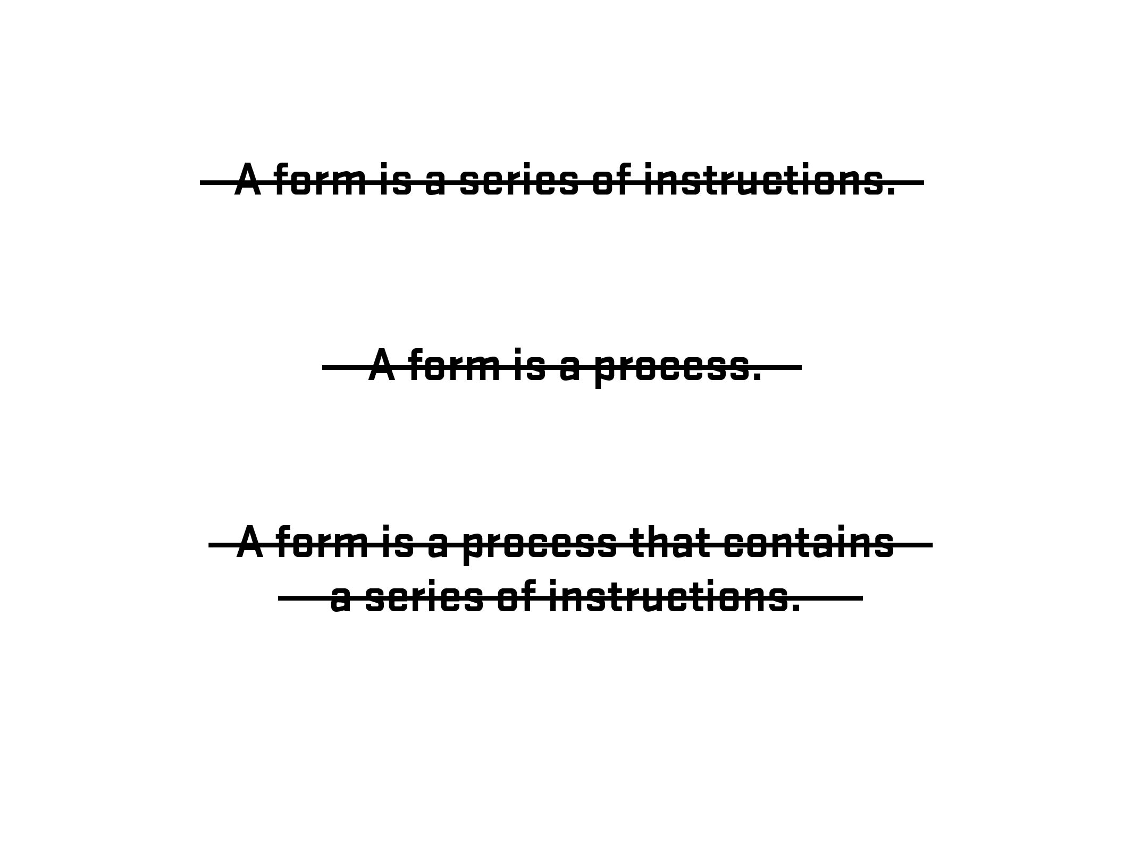

Slide 22
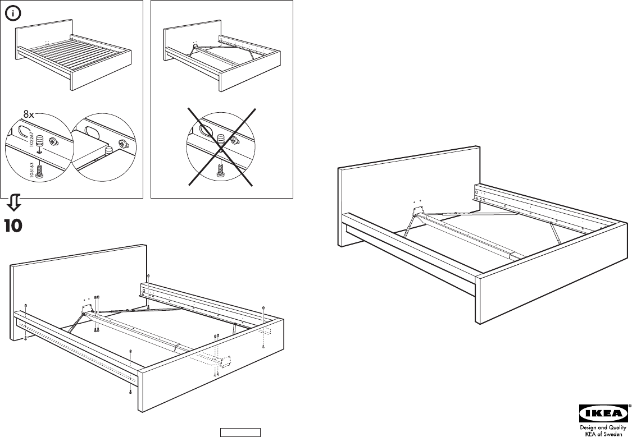

Slide 23

Photo – Space Lab, Vancouver, Canada (Clint Moroz)

Slide 24
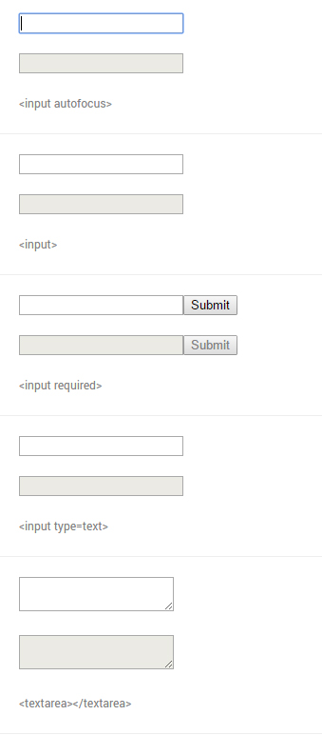
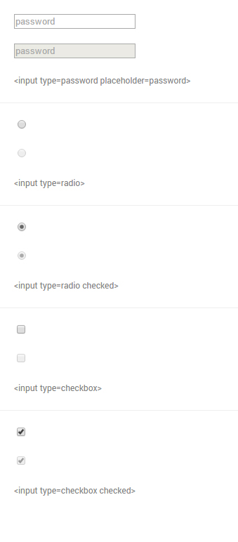
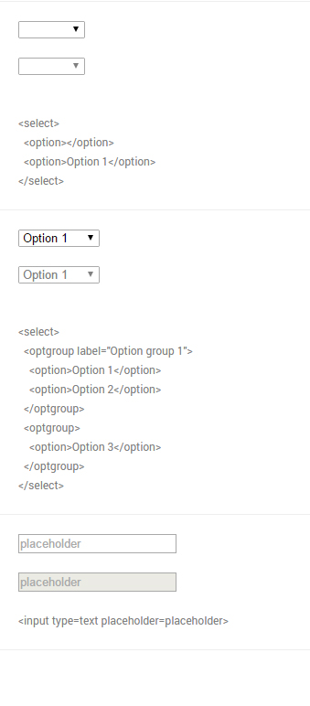
From Native form elements (http://nativeformelements.com/) - Joshua Jenkins

Slide 25
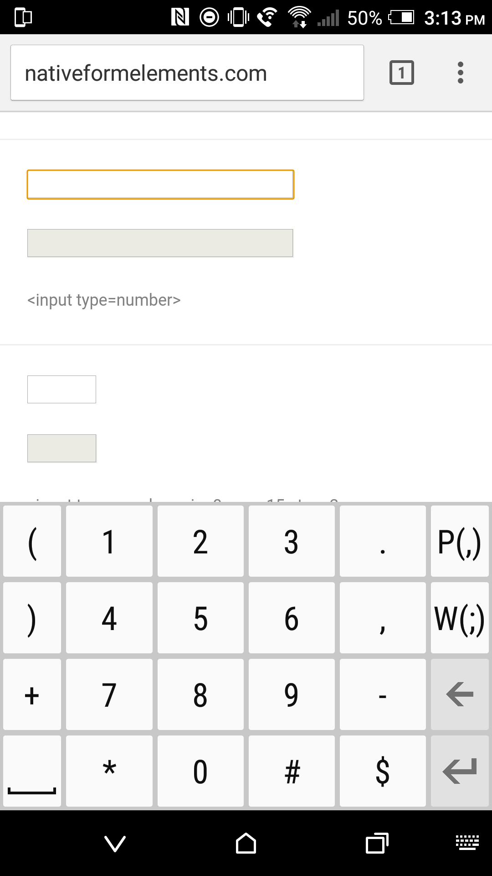
input type=“number”

Slide 26
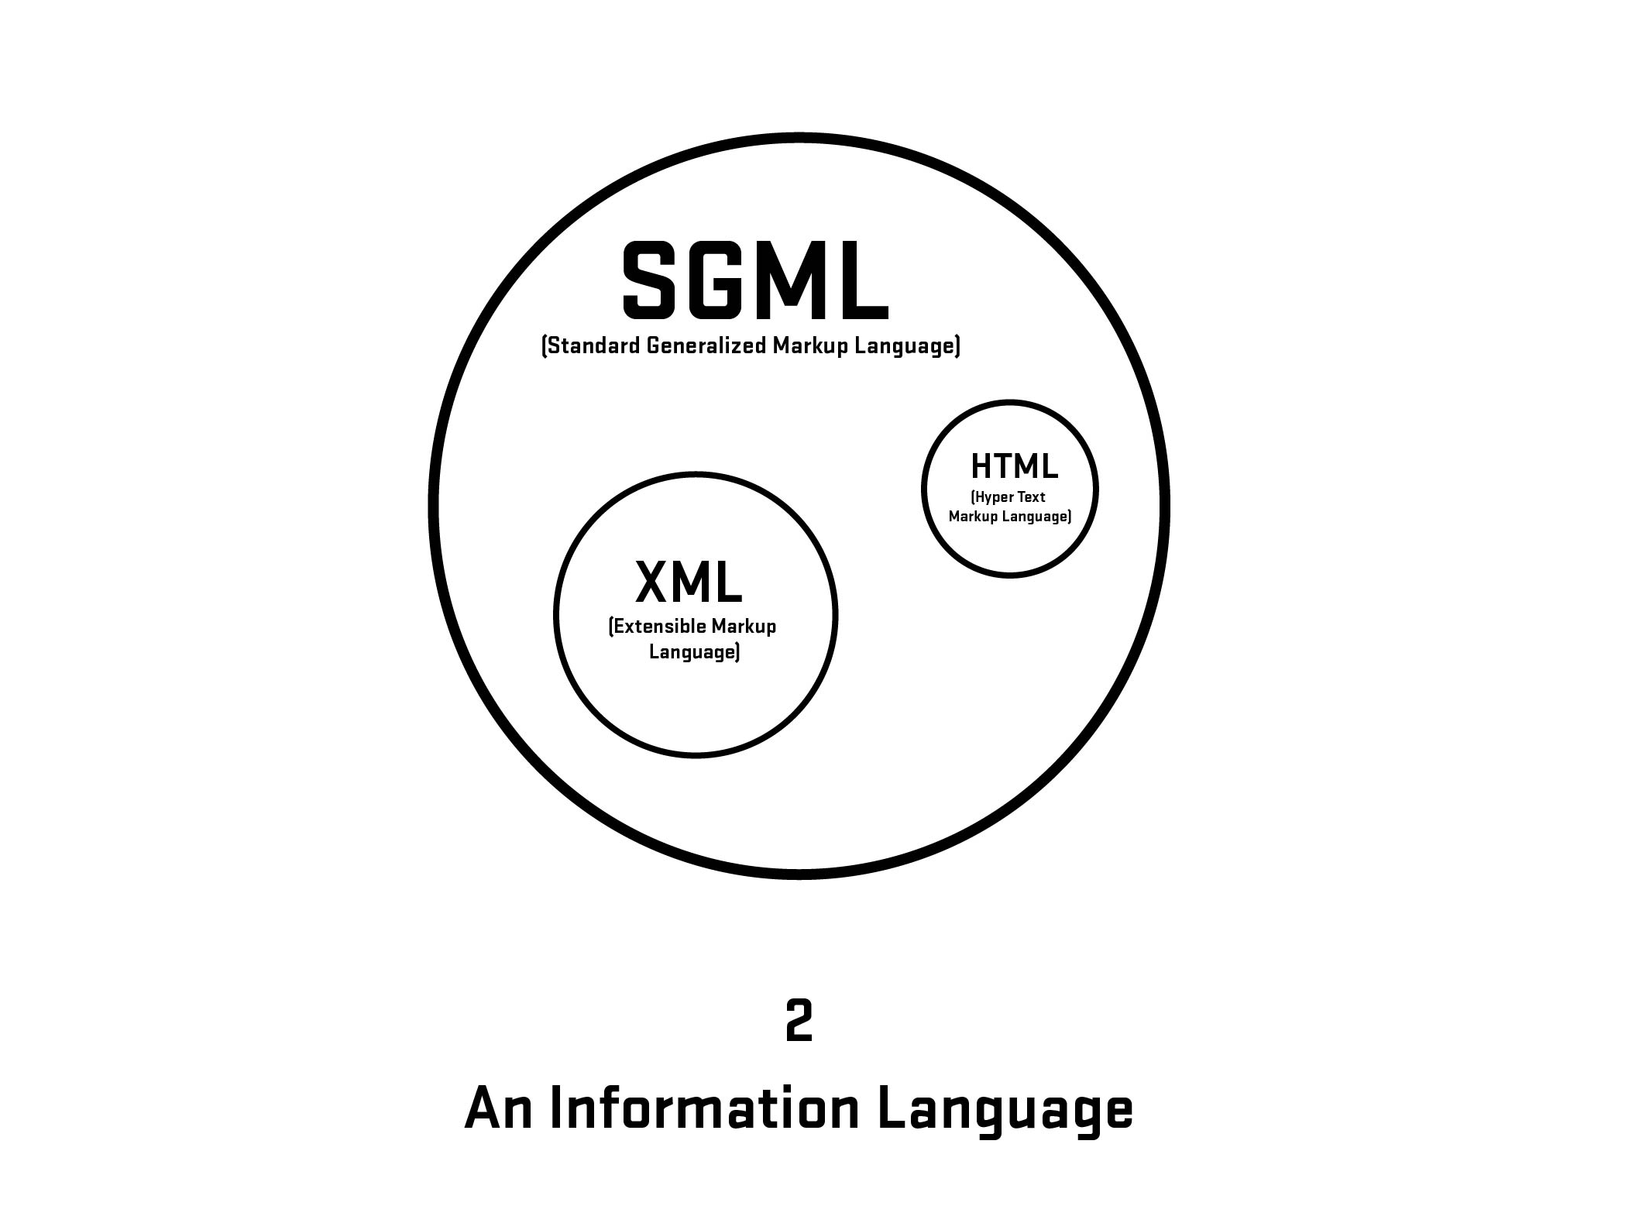

Slide 27
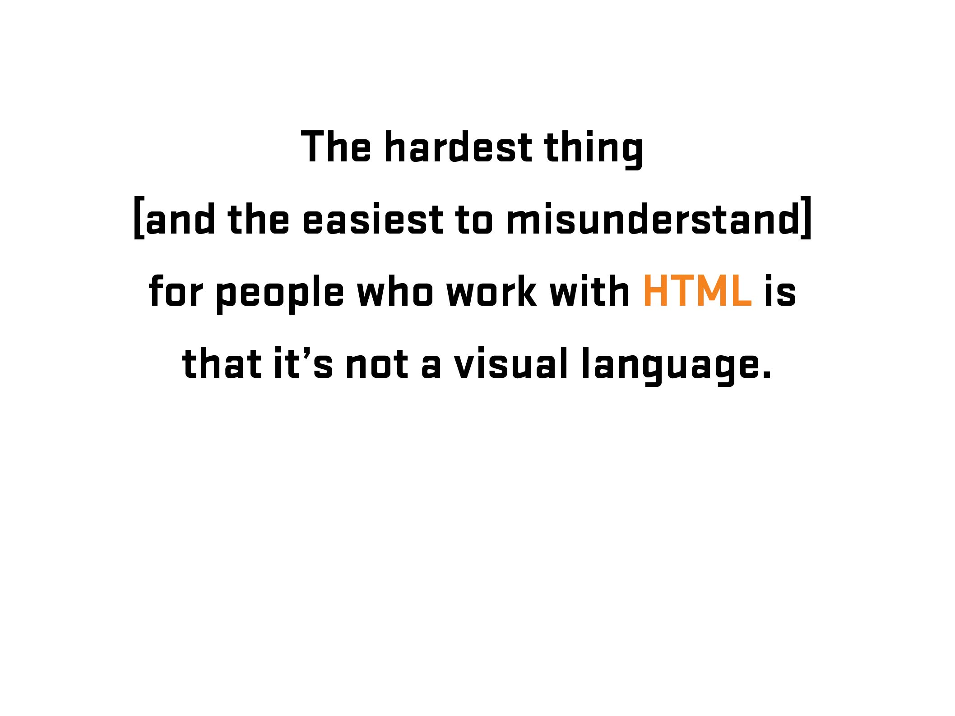

Slide 28
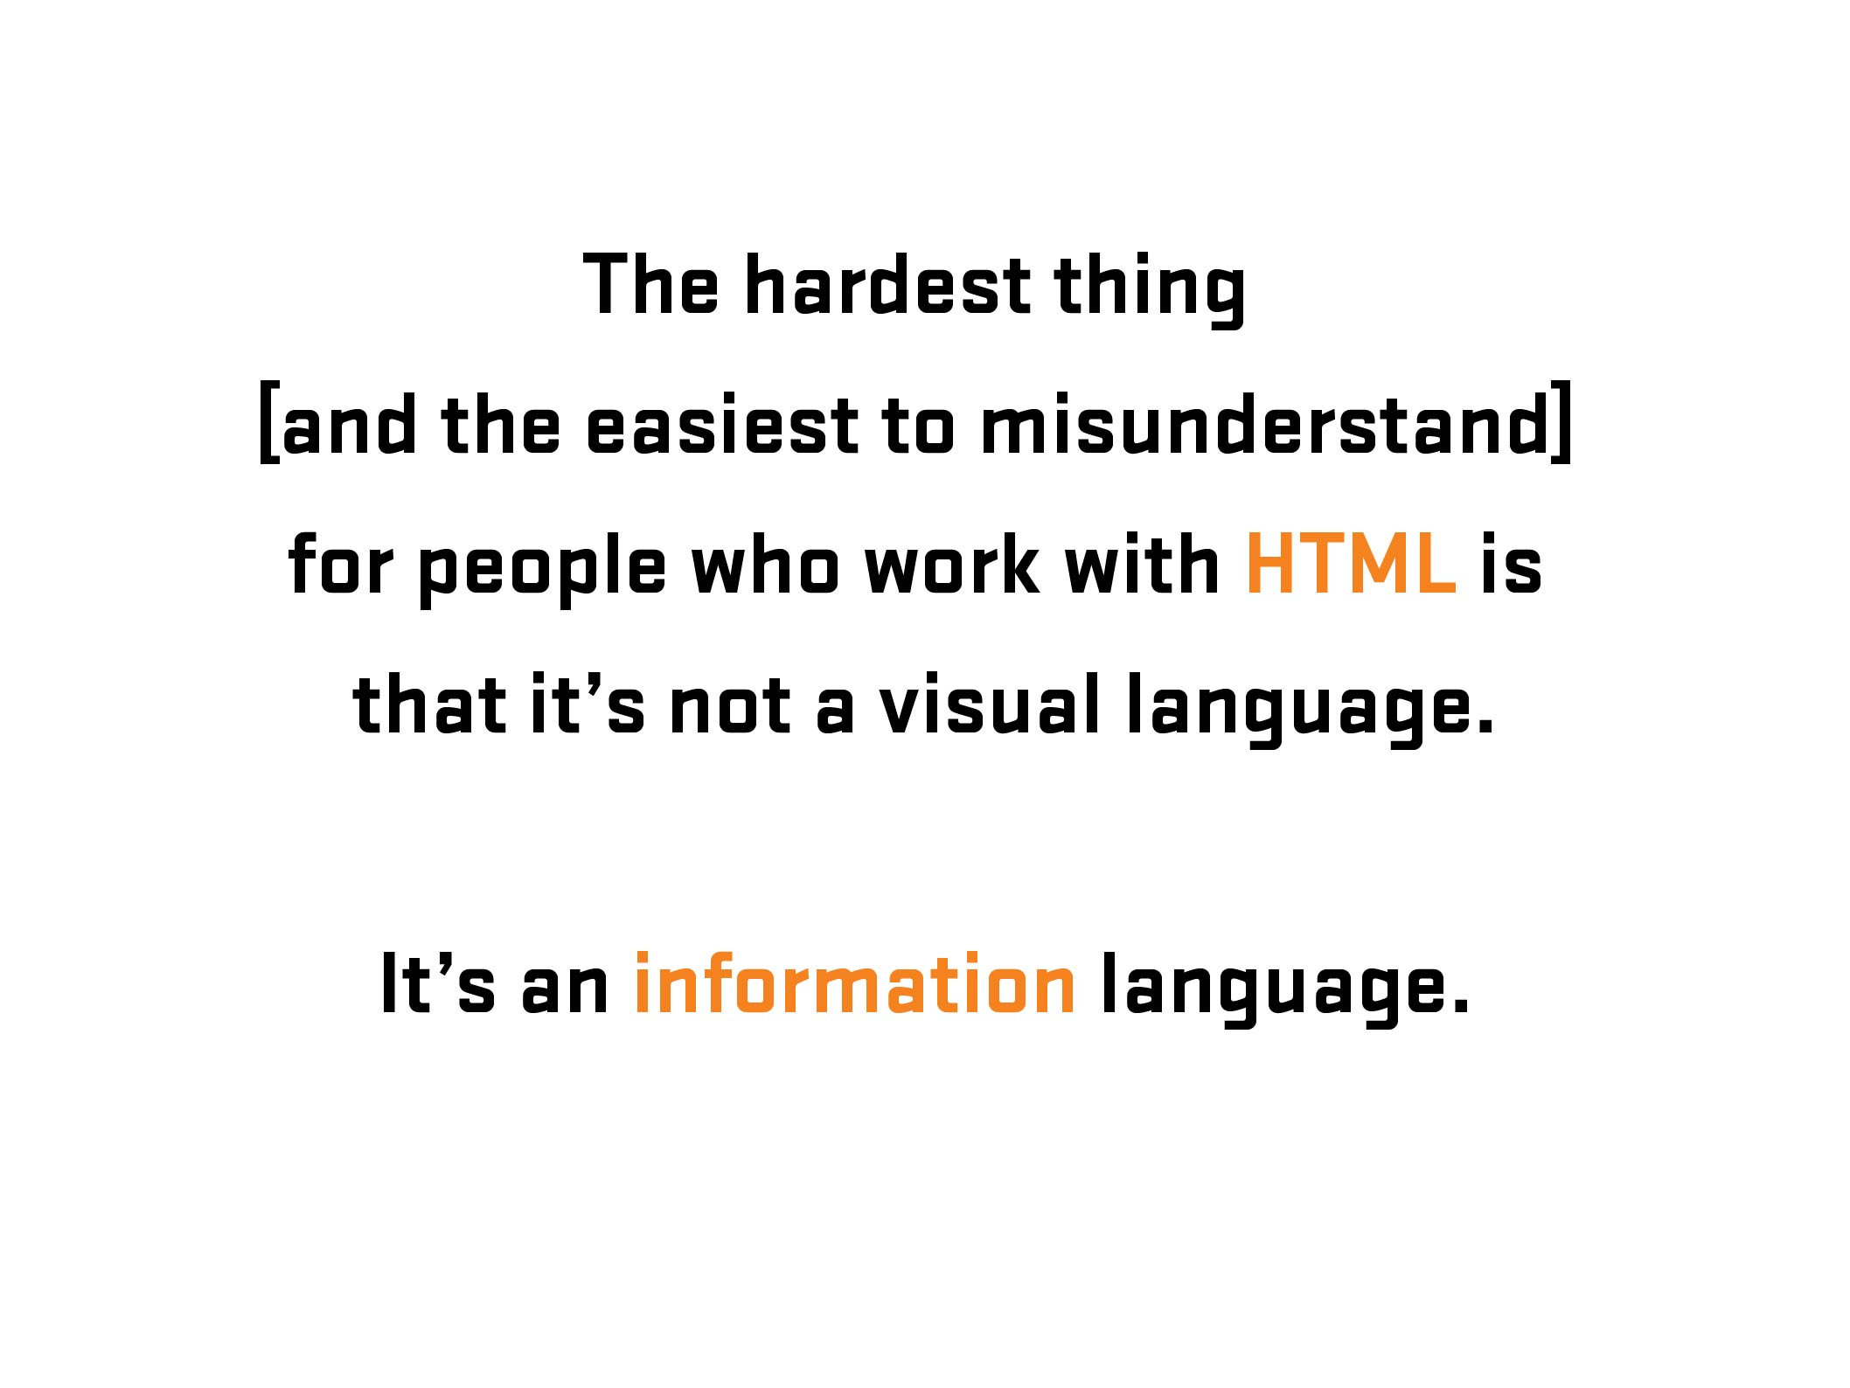

Slide 29

More Information: https://en.wikipedia.org/wiki/Kaieteur_Falls
Notes:
Kaiteur Falls, Guyana

Slide 30

Notes:
Kaiteur Falls, Guyana

Slide 31
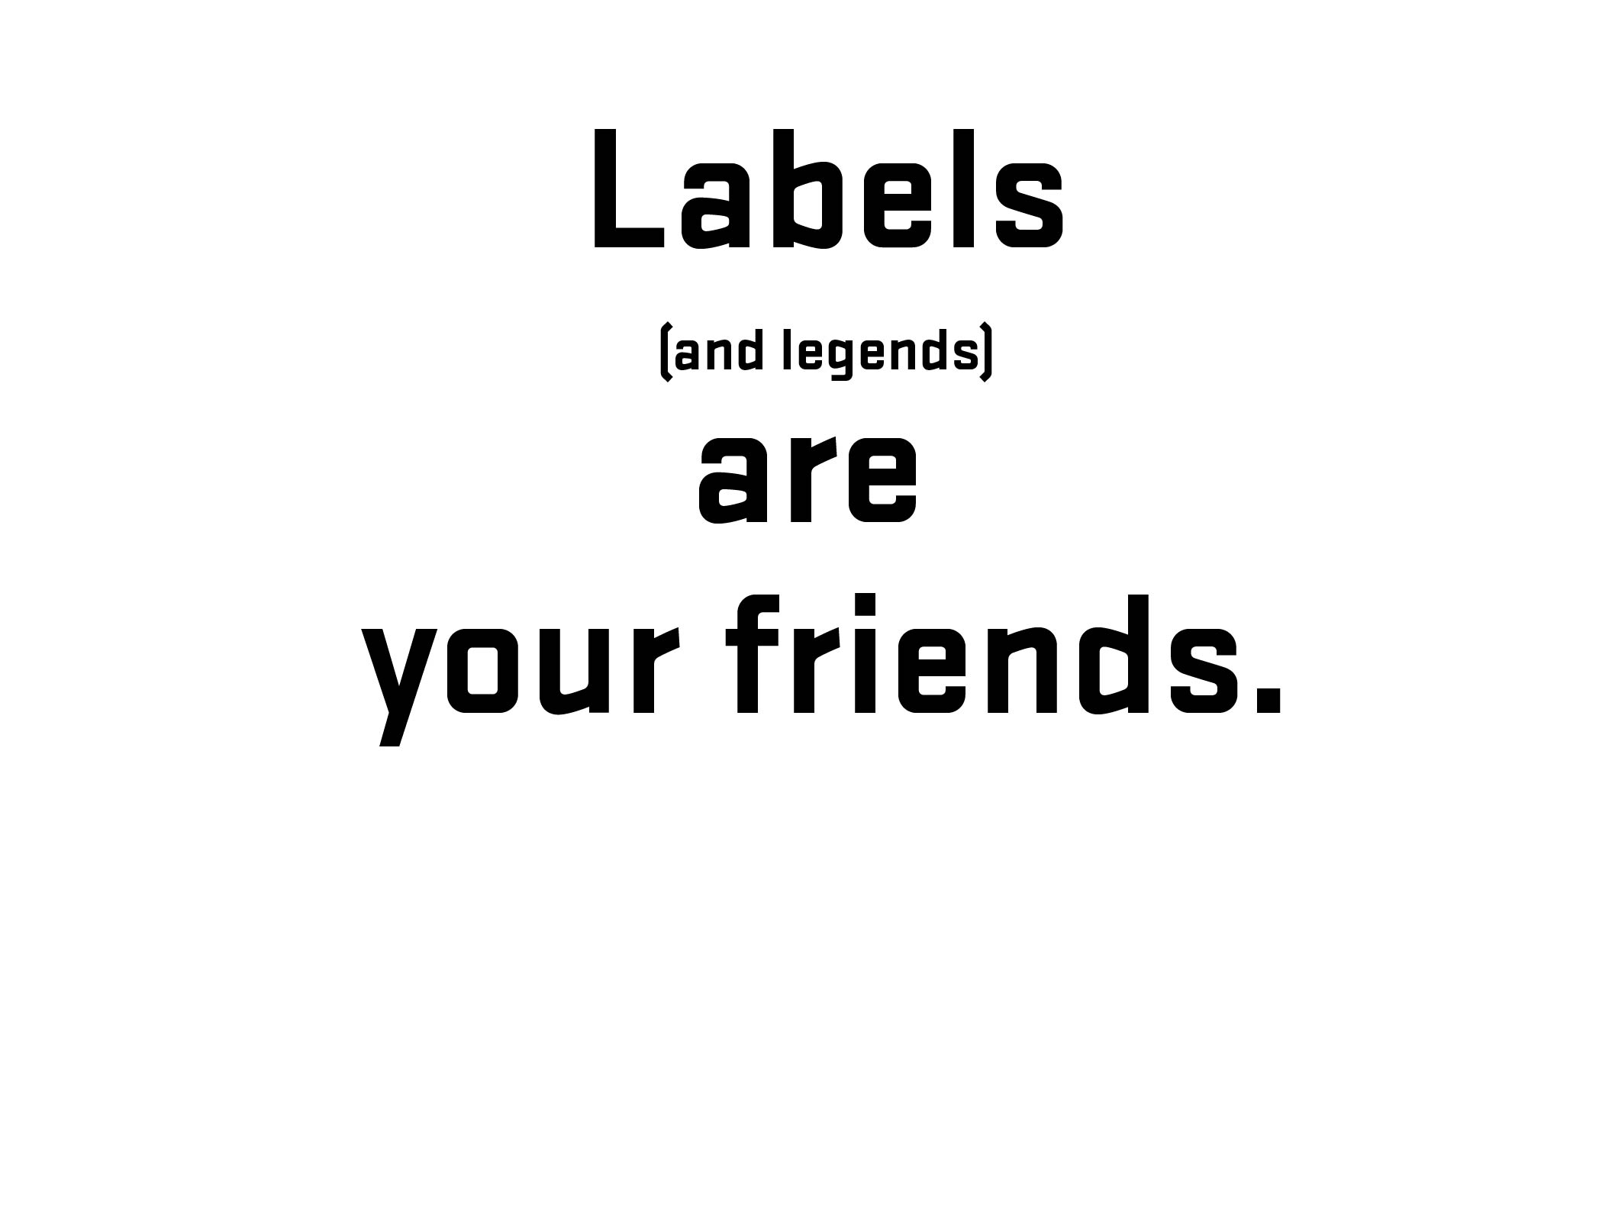
Notes:
Before going further – 1) explain what labels are and 2) what is that difference between placeholder and labels (and why that is important)

Slide 32

Notes:
Before going further – 1) explain what labels are and 2) what is that difference between placeholder and labels (and why that is important)

Slide 33
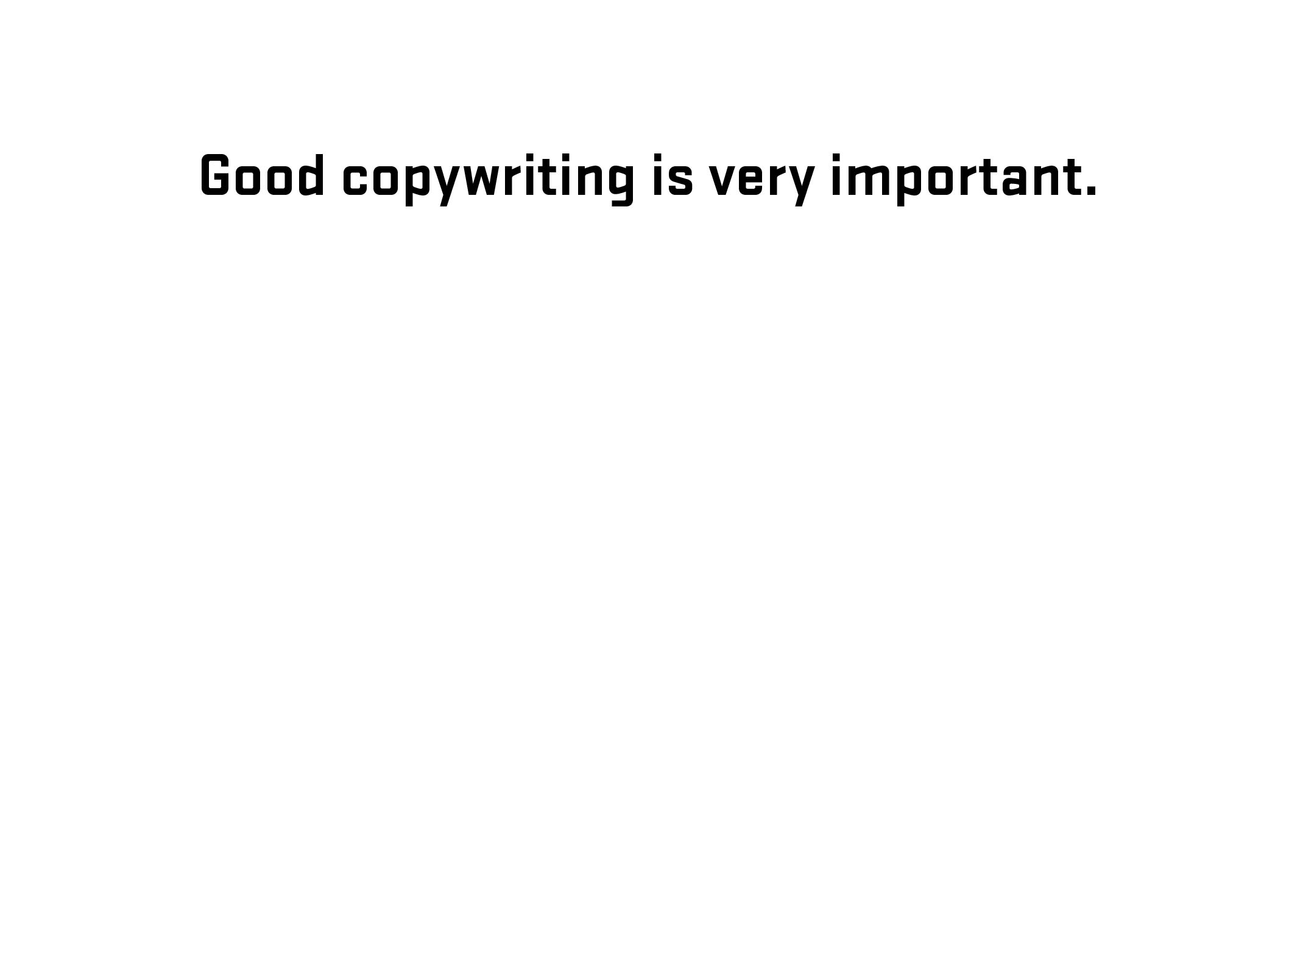
Notes:
Diversion – side note about good writing for labels (copywriting)

Slide 34
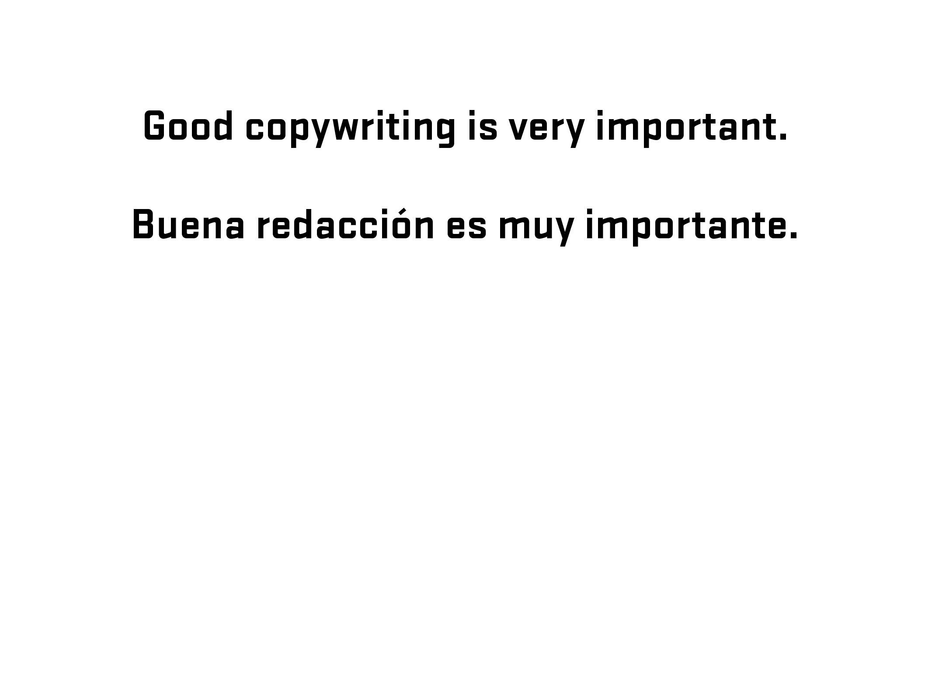
Notes:
Diversion – side note about good writing for labels (copywriting)

Slide 35

Notes:
Diversion – side note about good writing for labels (copywriting)

Slide 36
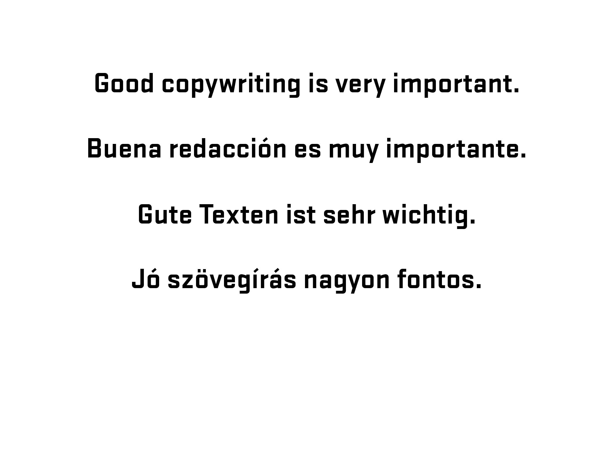
Notes:
Diversion – side note about good writing for labels (copywriting)

Slide 37
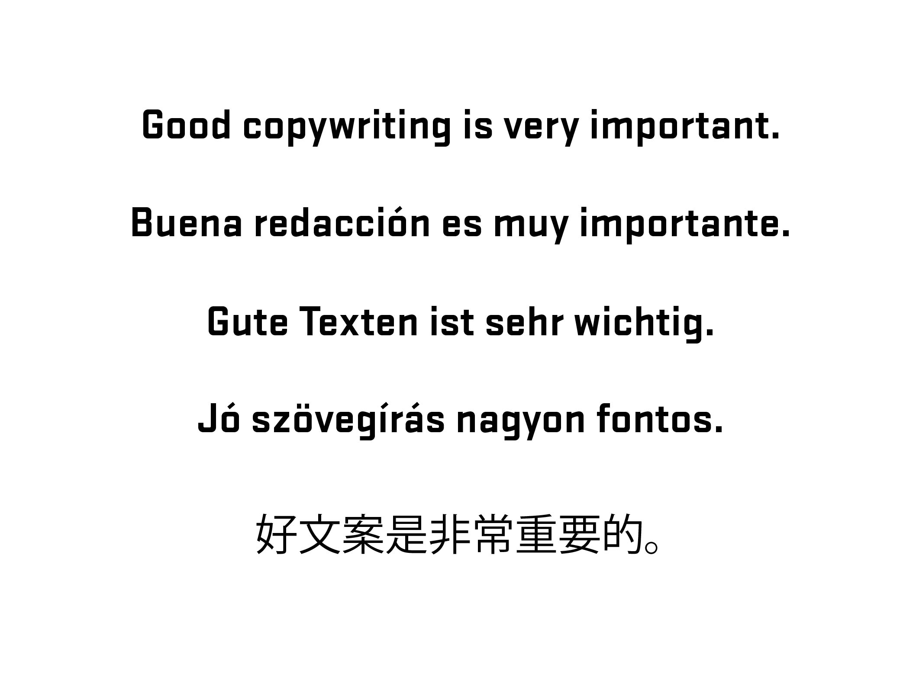
Notes:
Diversion – side note about good writing for labels (copywriting)

Slide 38
JS
/
ARIA

Slide 39
WAI-ARIA
WAI-ARIA (Web Accessibility Initiative – Accessible Rich Internet Applications) is a technical specification published by the World Wide Web Consortium (W3C) that specifies how to increase the accessibility of web pages, in particular, dynamic content and user interface components developed with Ajax, HTML, JavaScript and related technologies.
- Wikipedia (https://en.wikipedia.org/wiki/WAI-ARIA)
Notes:
Brief overview of history/explanation. Go further if needed – refer to W3C.
Need list of resources for audience

Slide 40
ARIA Landmark Roles
Notes:
Quick explanation of landmark roles. Using in combination with HTML (not duplicating)

Slide 41
aria-live = [off, polite, assertive, rude]
aria-describedby = [element id]
aria-labelledby = [element id]

Slide 42
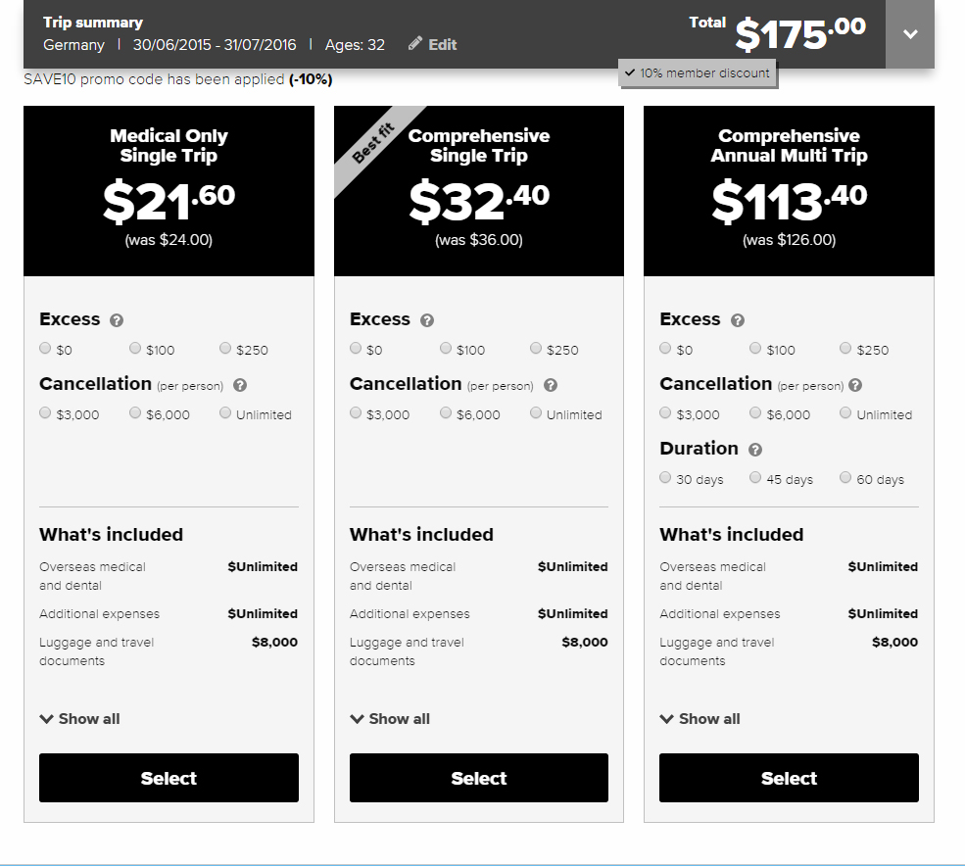

Slide 43
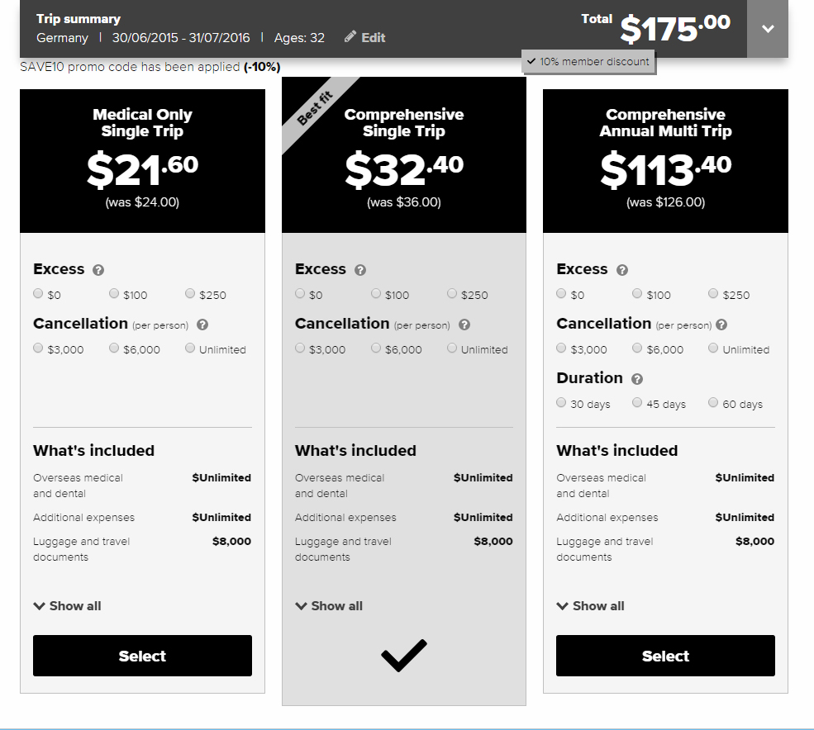

Slide 44
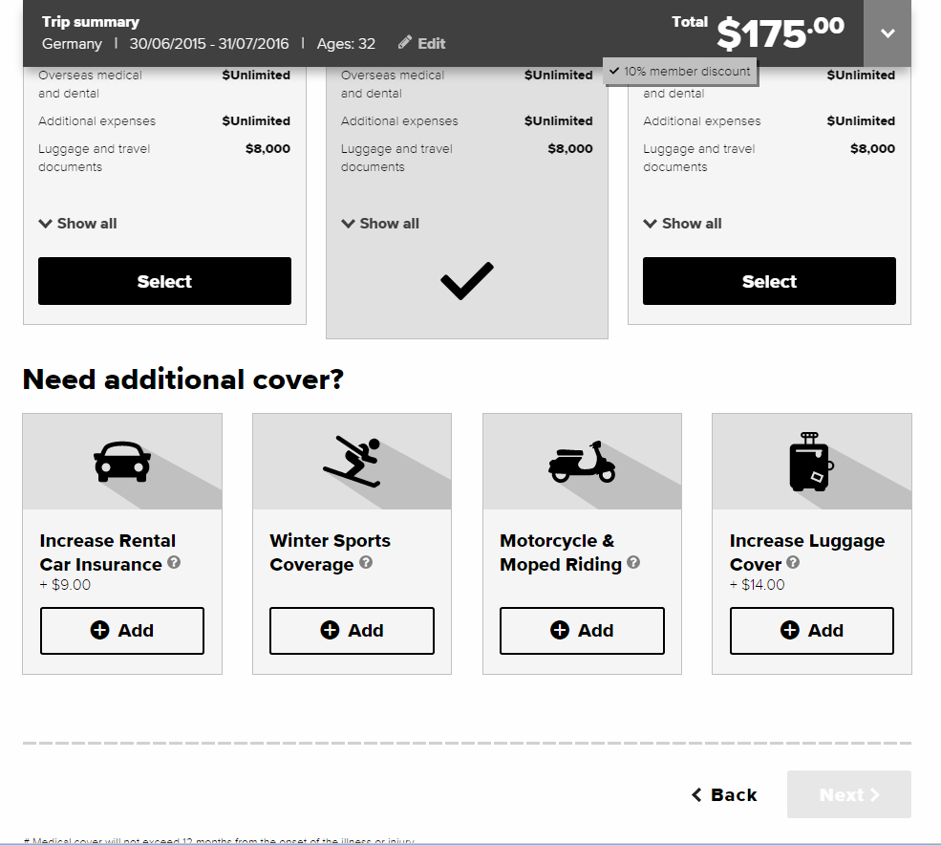

Slide 45
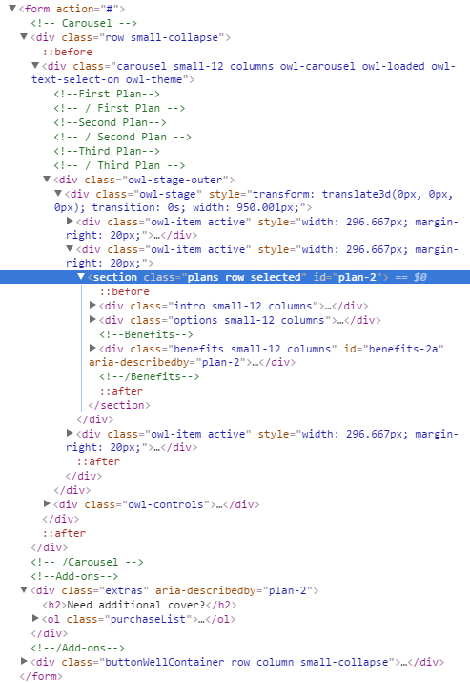

Slide 46
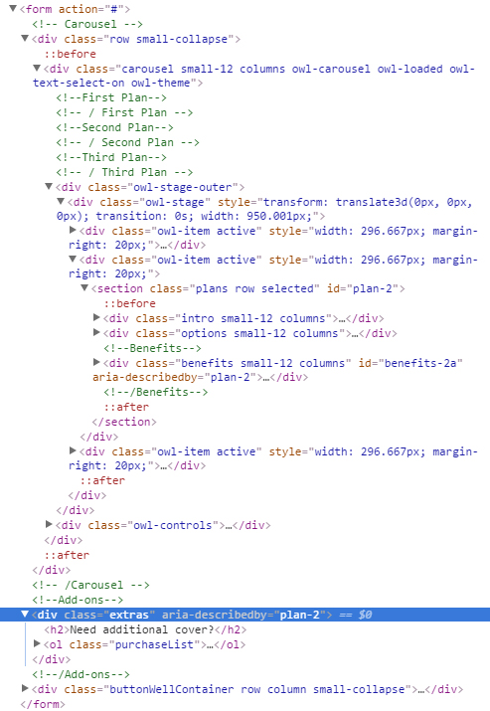

Slide 47
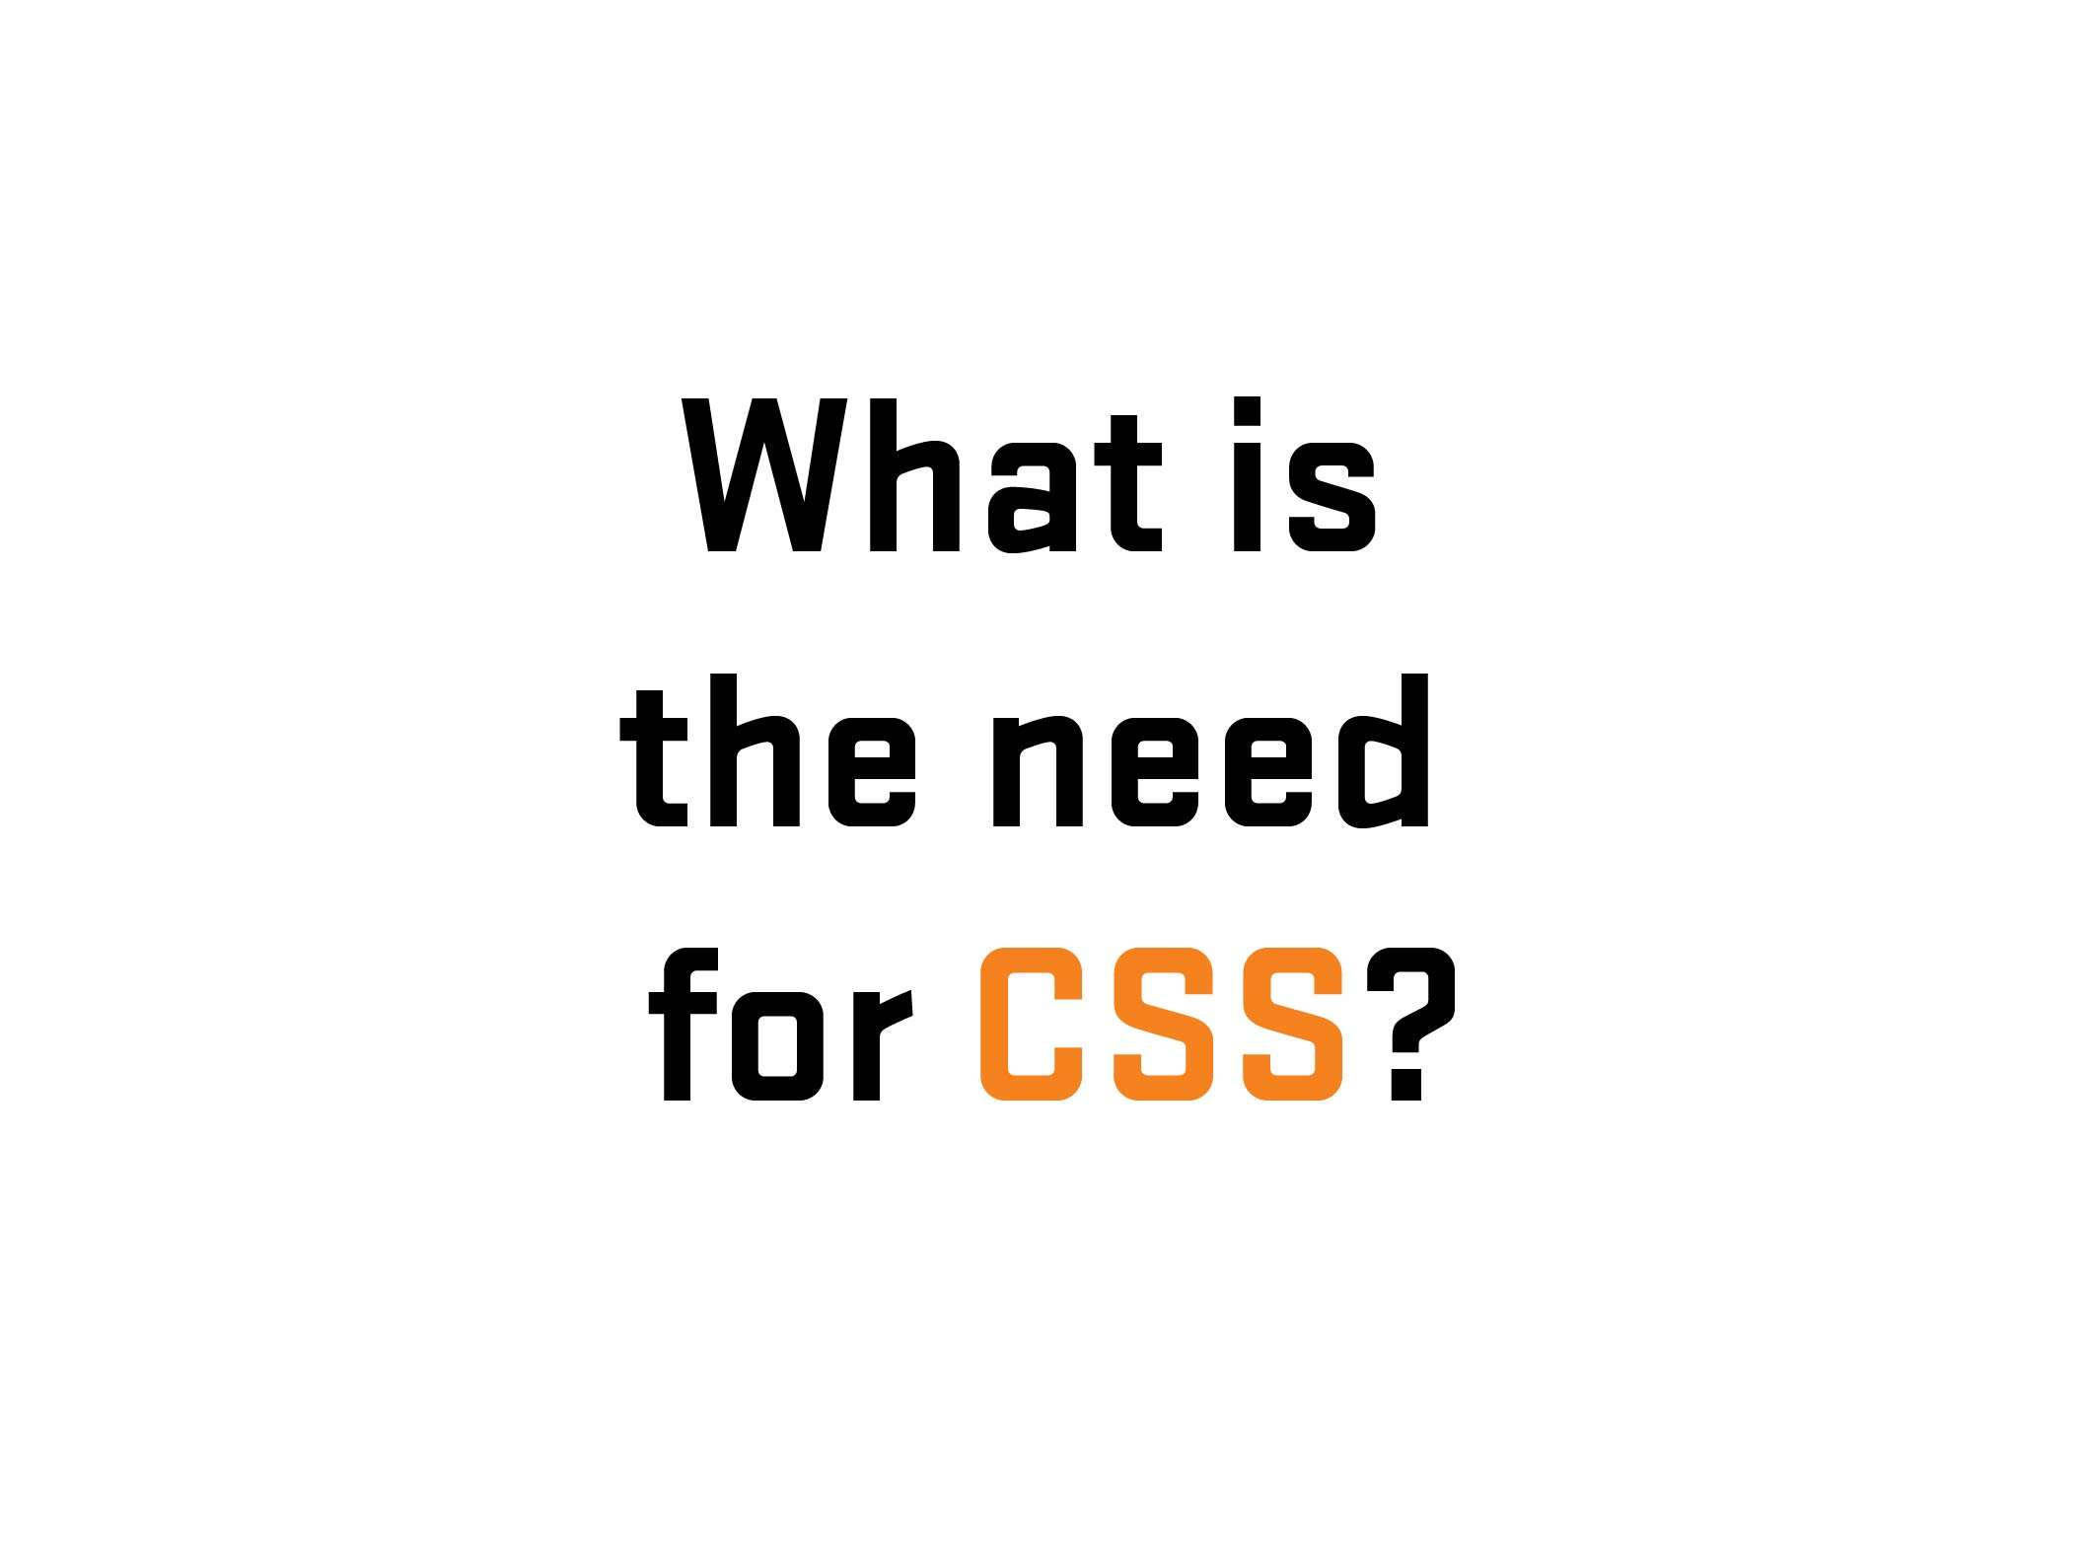

Slide 48
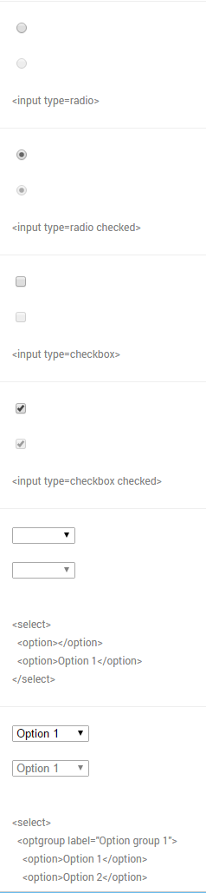
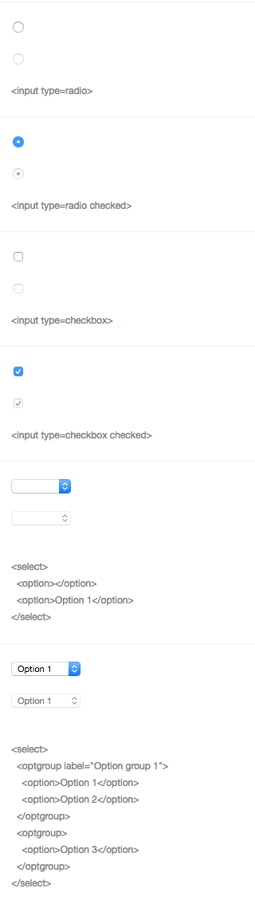
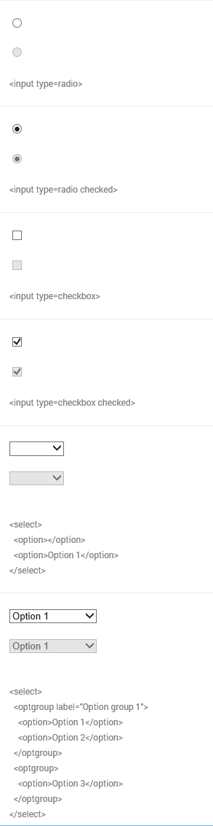
Chrome
Windows 10
Chrome
Yosemite
IE 11
Windows 10
Notes:
Differences of form UI’s among browsers/platforms

Slide 49
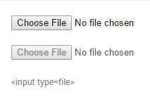
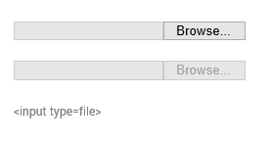
File Input
(Chrome/Firefox/Safari)
File Input
(IE/Edge)
Notes:
Differences of form UI’s among browsers/platforms (mobile)

Slide 50
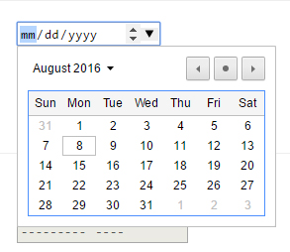
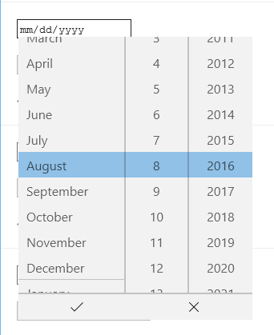
Chrome
Windows 10
Edge
Windows 10
Notes:
Another example – Date input (different look/functionality/UI) – Desktop
Go to nativeformelements.com for brief demo

Slide 51
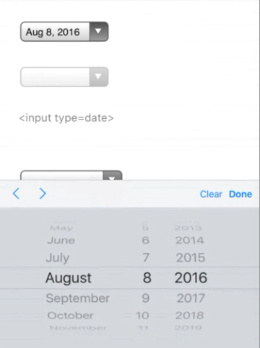
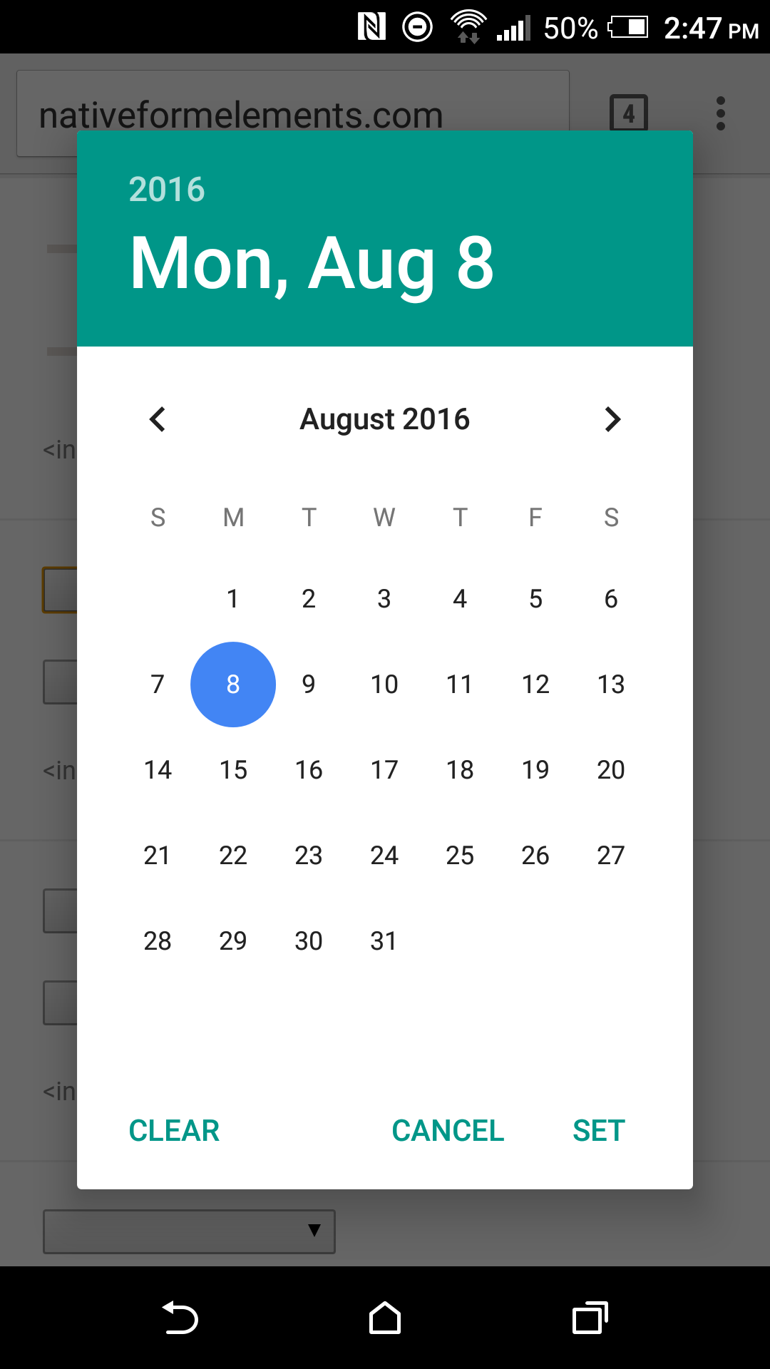
iPhone 6S Plus
iOS 9
HTC One M8
Android Marshmellow (6)
Notes:
Another example – Date input (different look/functionality/UI) - Mobile

Slide 52
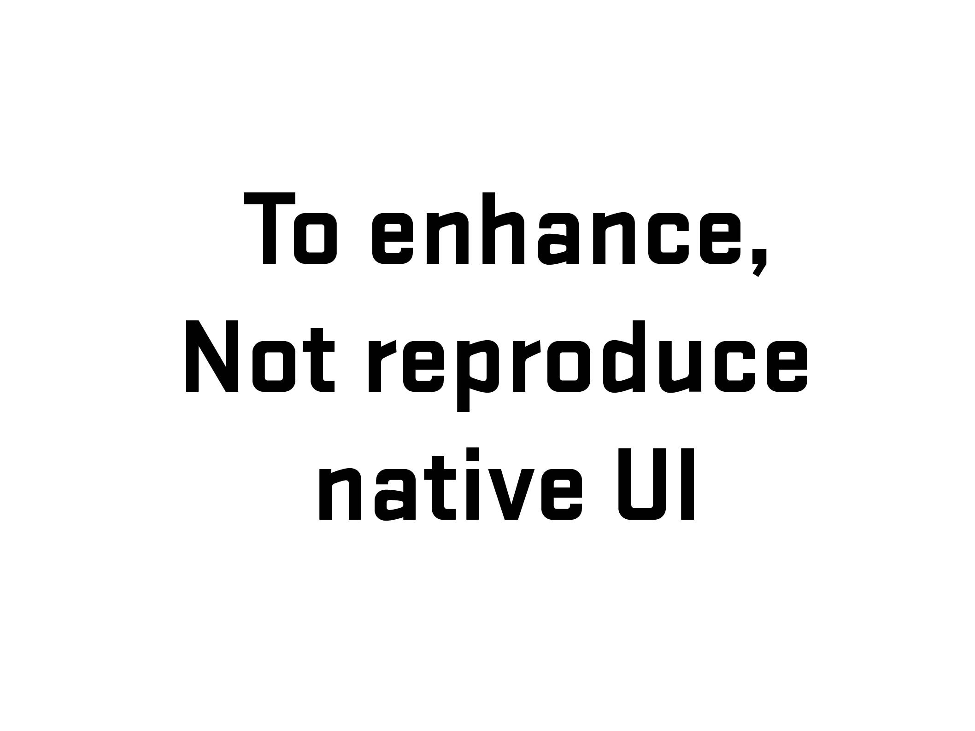
Notes:
Explanation
GEICO Story (2008-09)

Slide 53
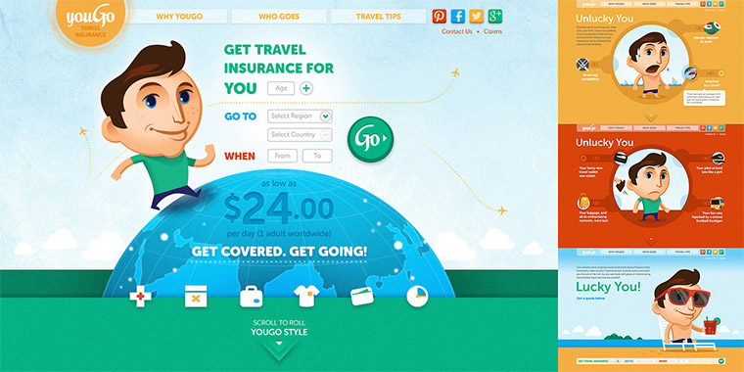
Notes:
youGo – travel insurance for under 30 crowd/Cover-More

Slide 54
Notes:
youGo/unlucky explanation – Visual (Choice #1)
Form with four set of radio buttons – no submit
(demo form)
Go to youGo site for demo - http://yougotravelinsurance.com.au/

Slide 55
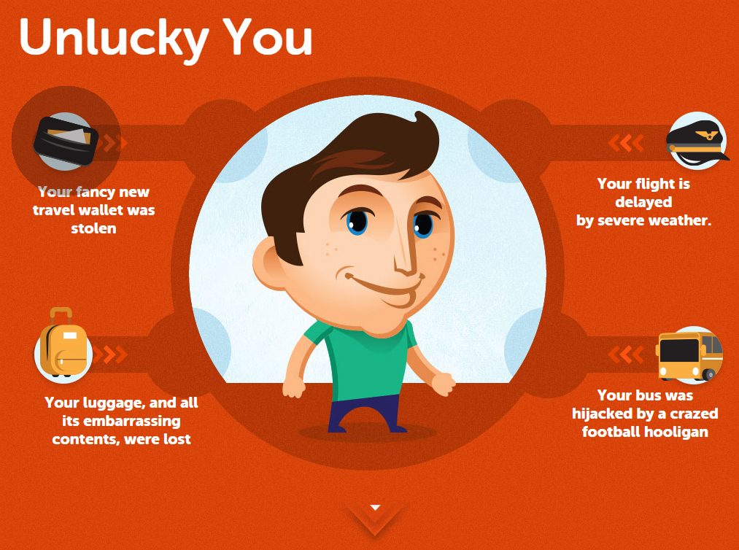
Notes:
youGo/unlucky explanation – Visual/Code (Choice #1)

Slide 56
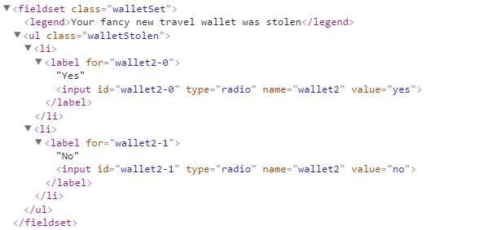
Notes:
youGo/unlucky explanation – Visual/Code (Choice #1)

Slide 57
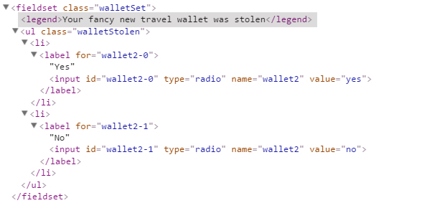
Notes:
youGo/unlucky explanation – Visual/Code (Choice #1)

Slide 58

Notes:
youGo/unlucky explanation – Visual/Code (Choice #1)

Slide 59


Notes:
youGo/unlucky explanation – Visual/Code (Choice #1)

Slide 60


Slide 61

Notes:
Start story on adding grid from Air NZ to landing page
http://www.airnewzealand.co.nz/travel-insurance/

Slide 62


Slide 63


Slide 64
Notes:
The problem: is the client insisted that we added the grid to our new (responsive) purchase process. But…

Slide 65


Notes:
Yup.

Slide 66

Notes:
Solved problem with two prong/server page approach – one desktop/one mobile. Which is an viable option (see McGrane/adaptive solutions). But at the time, it had hiccups (serving wrong page, etc.). Not a mess but not an ideal (responsive) solution.

Slide 67

Notes:
If I had a chance, what would I do…
So I wrote some notes…

Slide 68


Notes:
First thing, change the codebase (responsive/reduced JS/a11y?)
Allowed for direct data input (no JS)
Single code base (responsive)
A11y???

Slide 69

Notes:
Going back to the base – information language

Slide 70


Slide 71


Slide 72


Slide 73


Slide 74


Slide 75

Notes:
No JS in data entry – used for display/toggle

Slide 76
.ui-countryselector input[type="radio"]
+ label ~ div.columns {
overflow: hidden;
float: none;
position: absolute;
clip: rect(0,0,0,0);
width: 100%;
height: 0;
margin: 0;
padding: 0;
}

Slide 77
.ui-countryselector input[type="radio"]:checked
+ label ~ div.columns {
position: static;
height: auto;
}

Slide 78
.ui-countryselector input[type="radio"] + label ~ div.columns { overflow: auto; }

Slide 79

.ui-countryselector input[type="radio"]:checked + label ~ div.columns { float: left; height: 384px; }
Notes:
Note – hard to do due to bugs. Adjacent bug in both iOS (“+” didn’t work) and Android (needed fix). Thankfully, fixed in more recent versions.

Slide 80

Notes:
I found out during QA testing and was able to remove or work around some of the barriers.

Slide 81

Test!
Notes:
No excuse for not testing – getting problems out of the way. For the initial work, even had to test for Android 2.3…But the way, a moment of silence….

Slide 82
Memorial for Android 2.x testing

Slide 83


Slide 84
Thank You!
Ivan Wilson
Innate
CSS Dev Conference
San Antonio, Texas
October 17-19, 2016

